Slide 1
Automatic Plant Watering
Using Fuzzy Logic

Slide 2
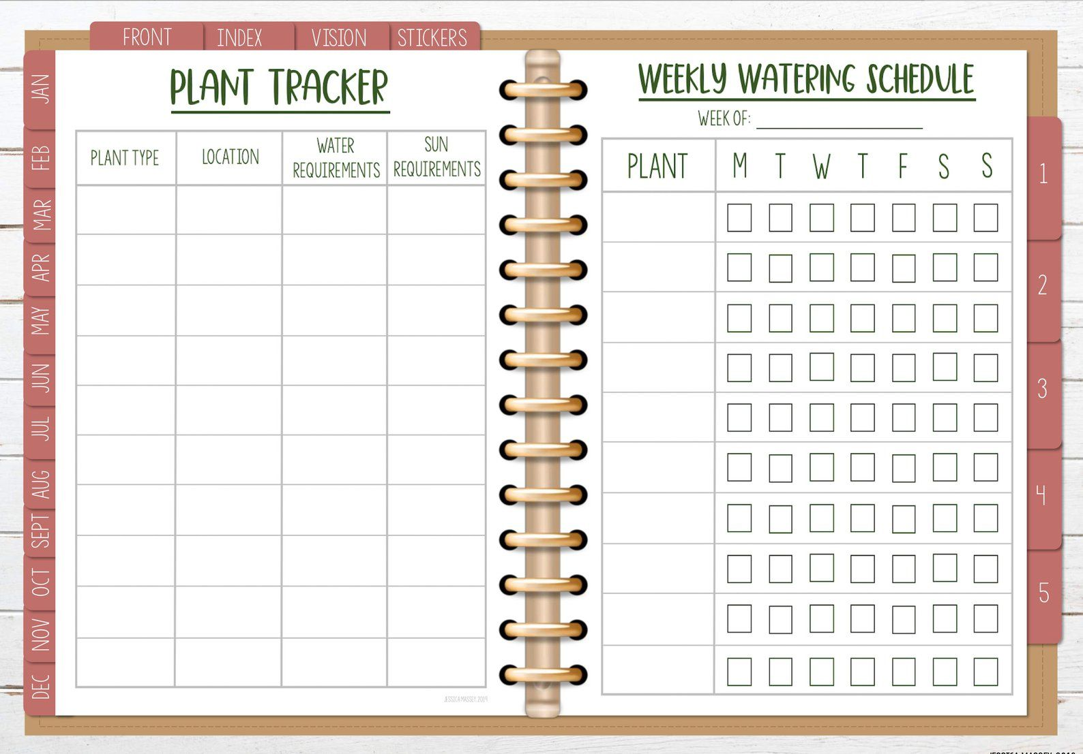
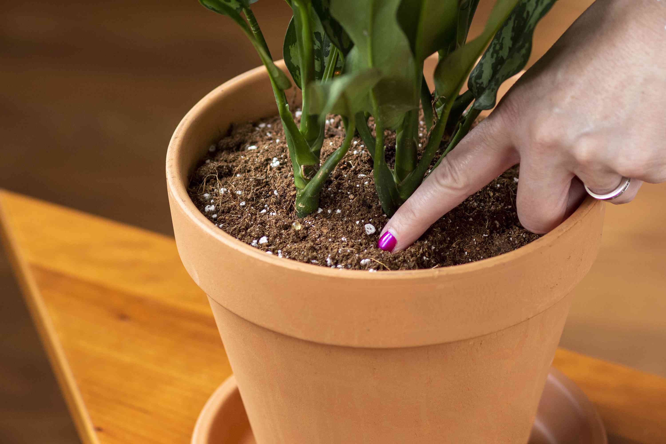
Common Ways
Regular Basis
Checking the soil moisture

Slide 3
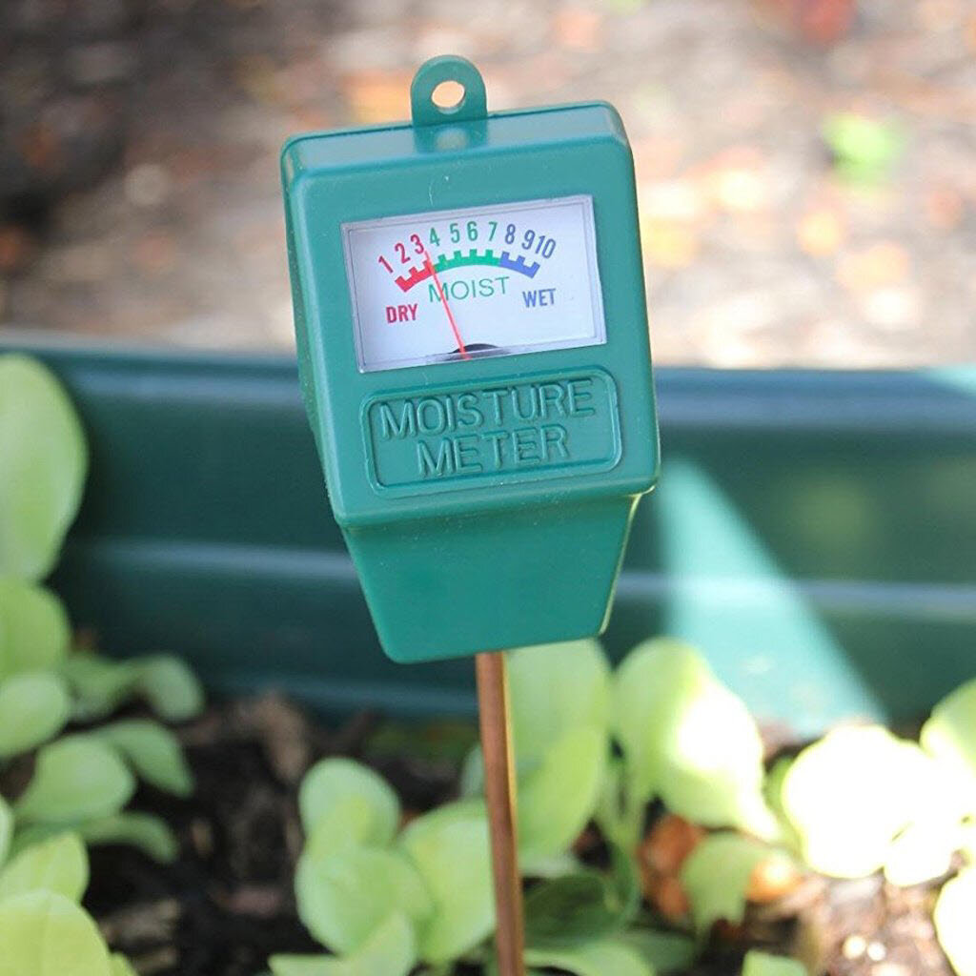
Soil Moisture Meter

Slide 4
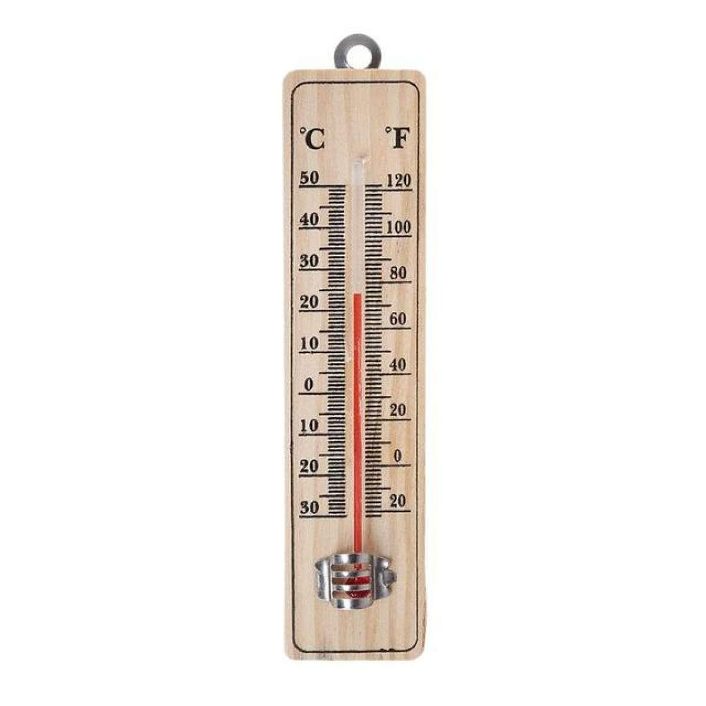
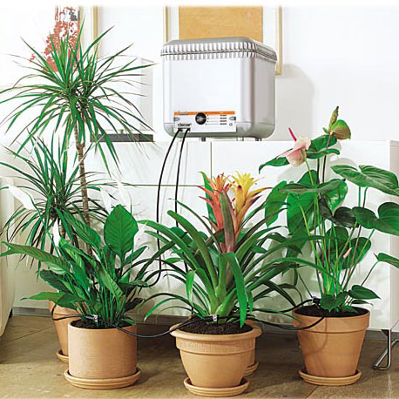
Automatic Plant Watering
Inputs
Output
=
Soil Moisture
Temperature
Water

Slide 5
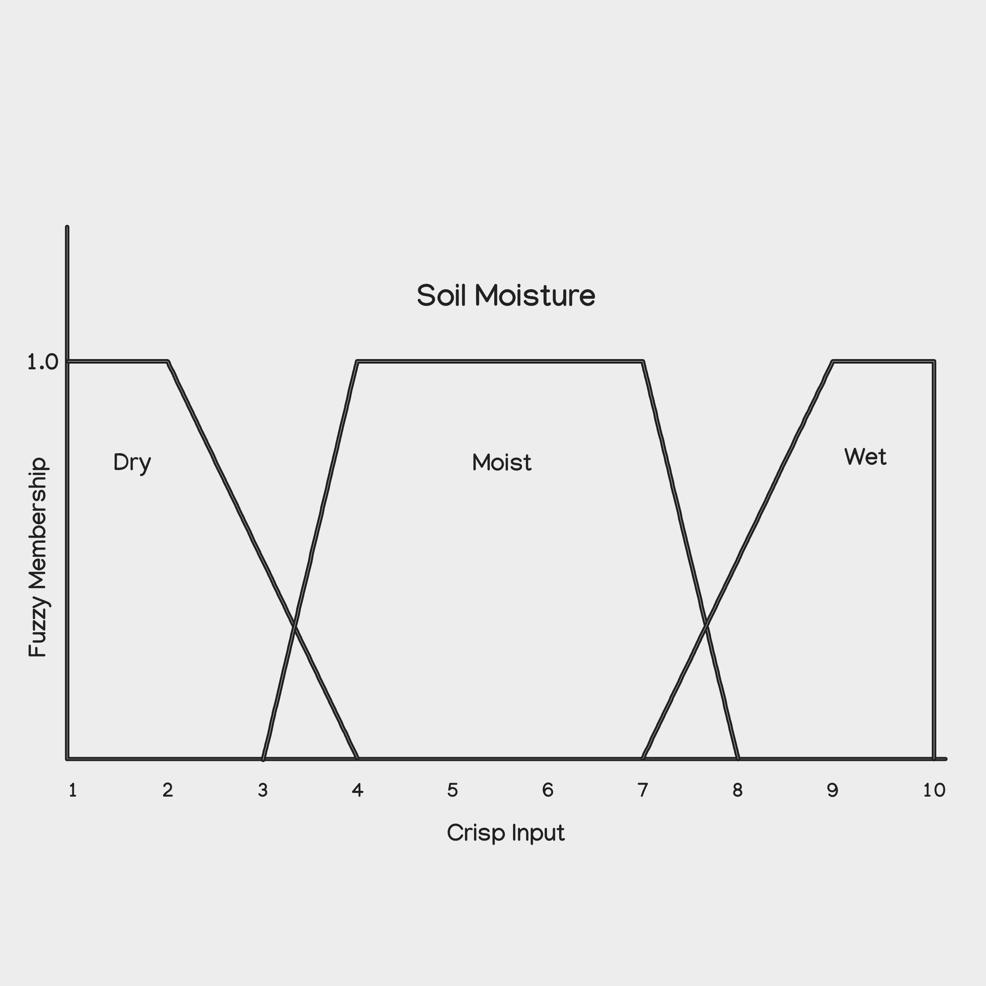
Membership Functions for Soil Moisture

Slide 6
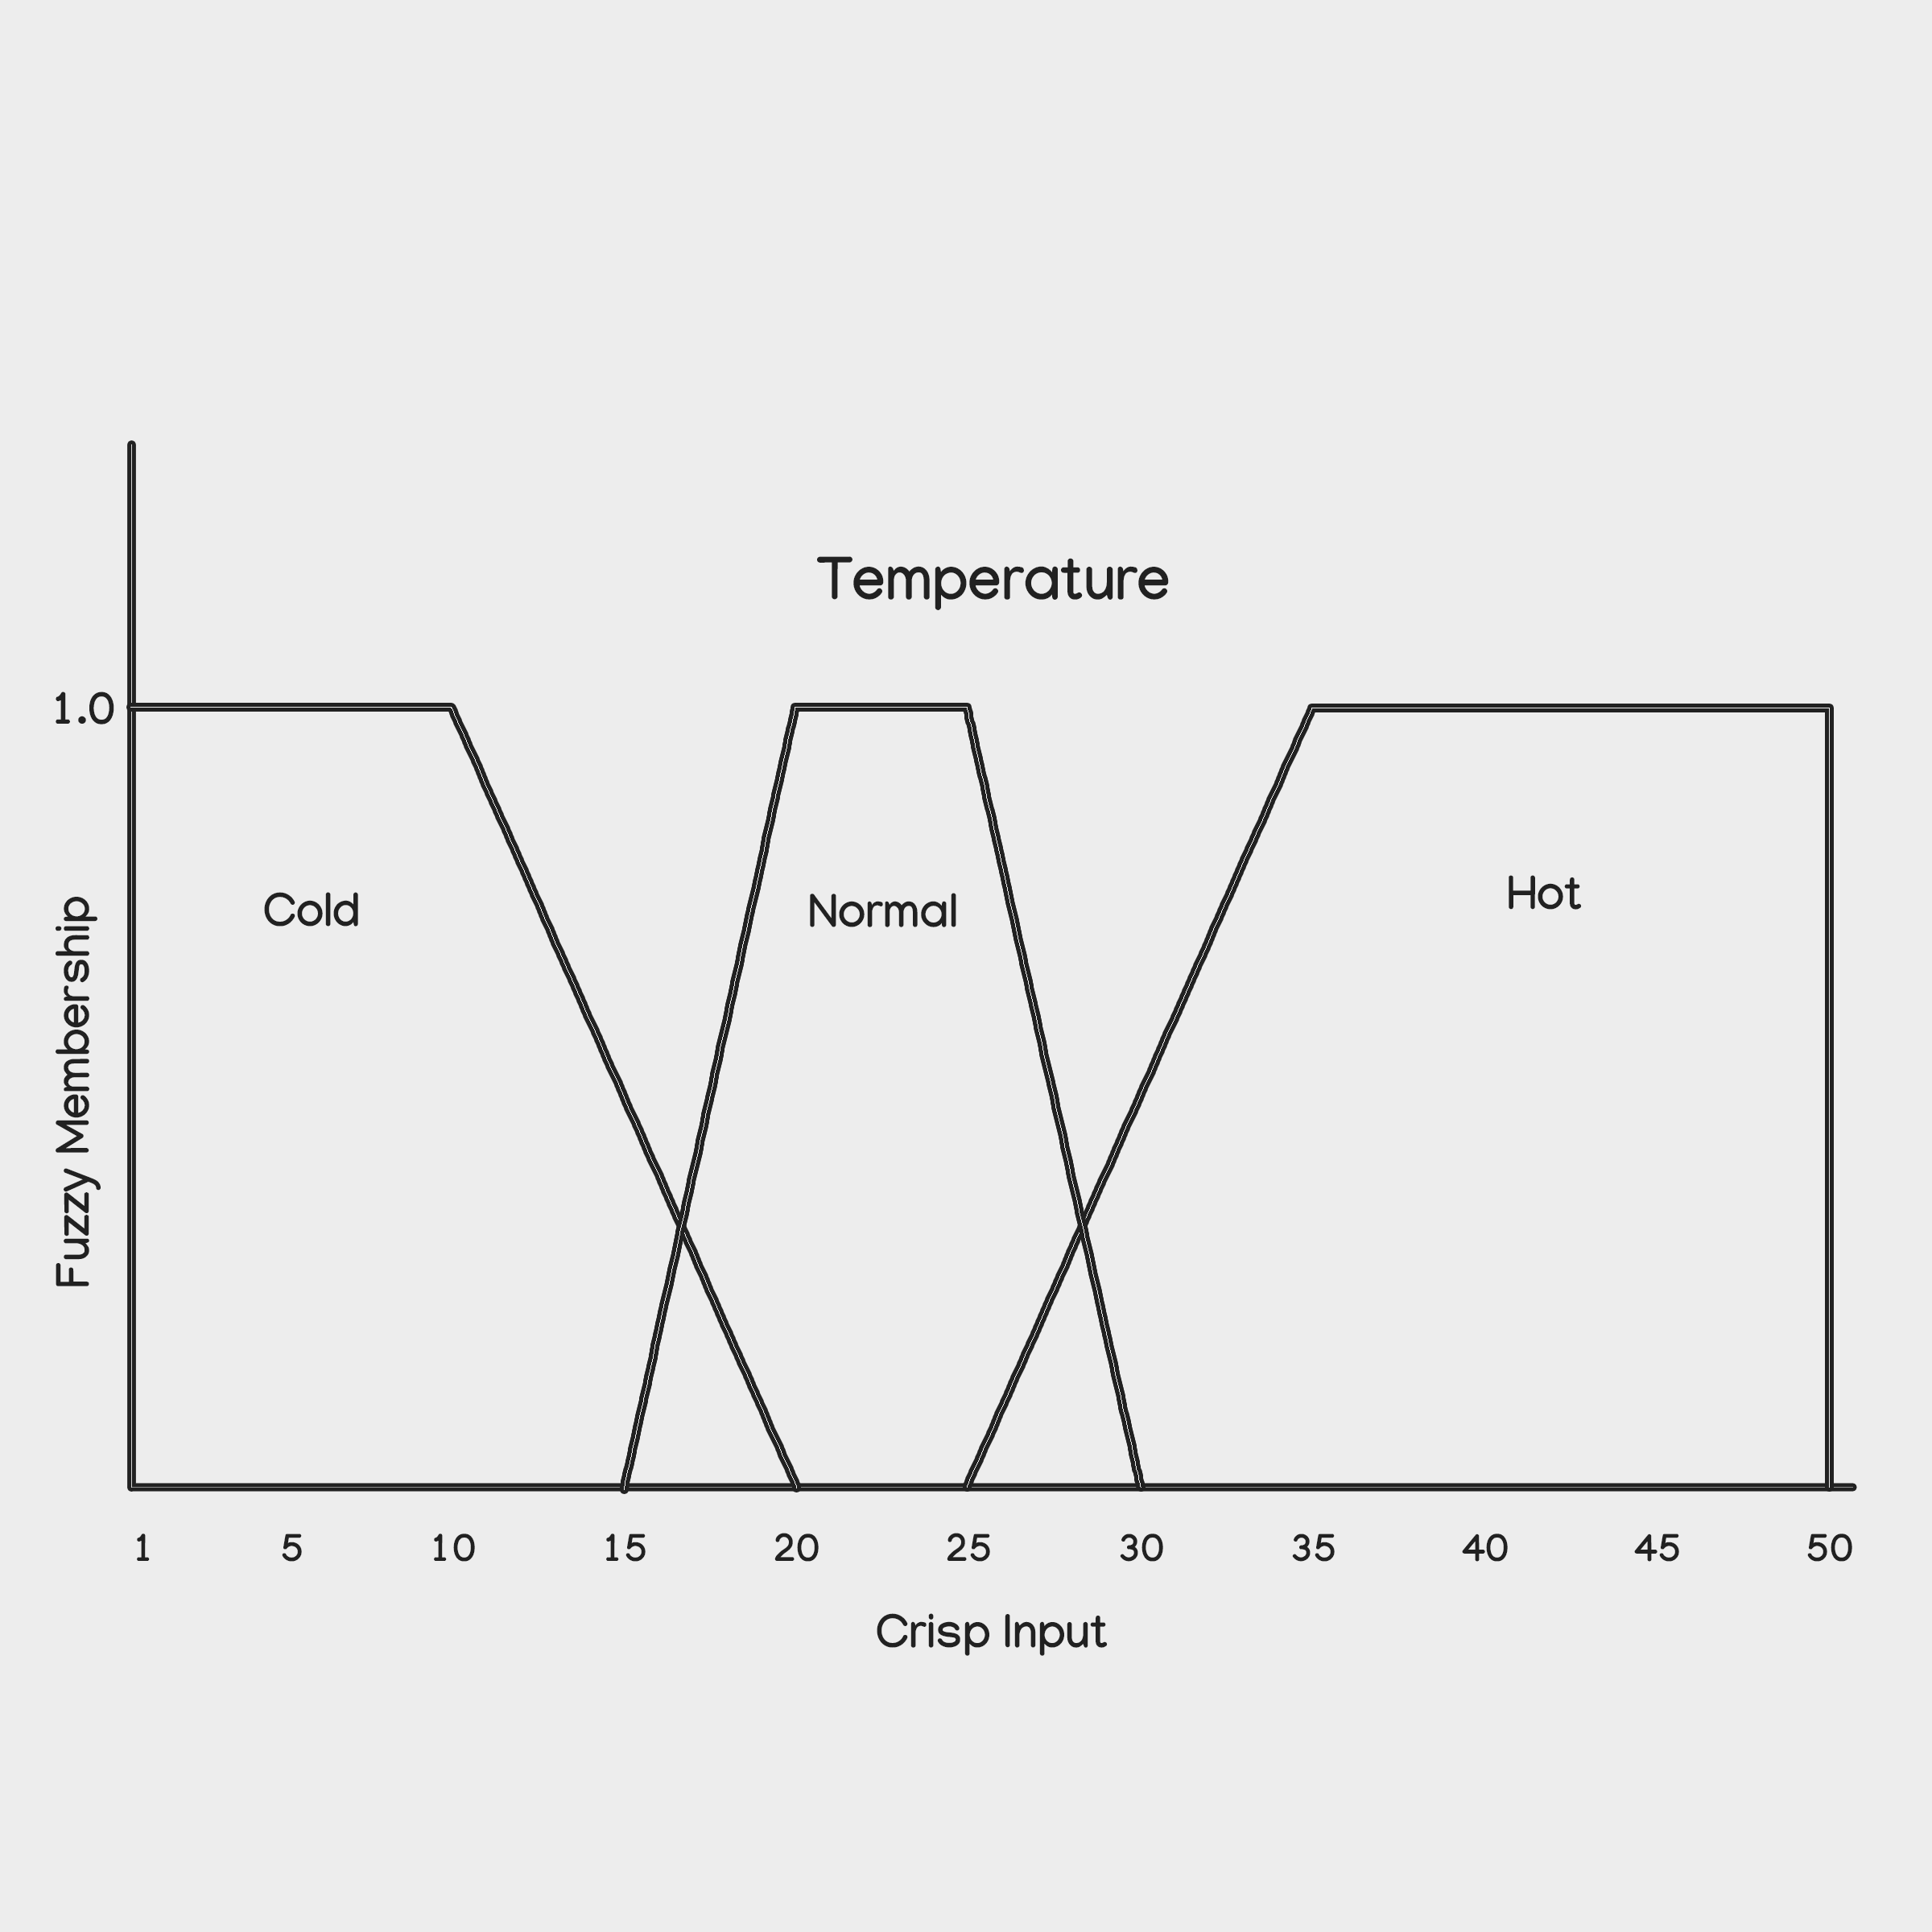
Membership Functions for Temperature

Slide 7
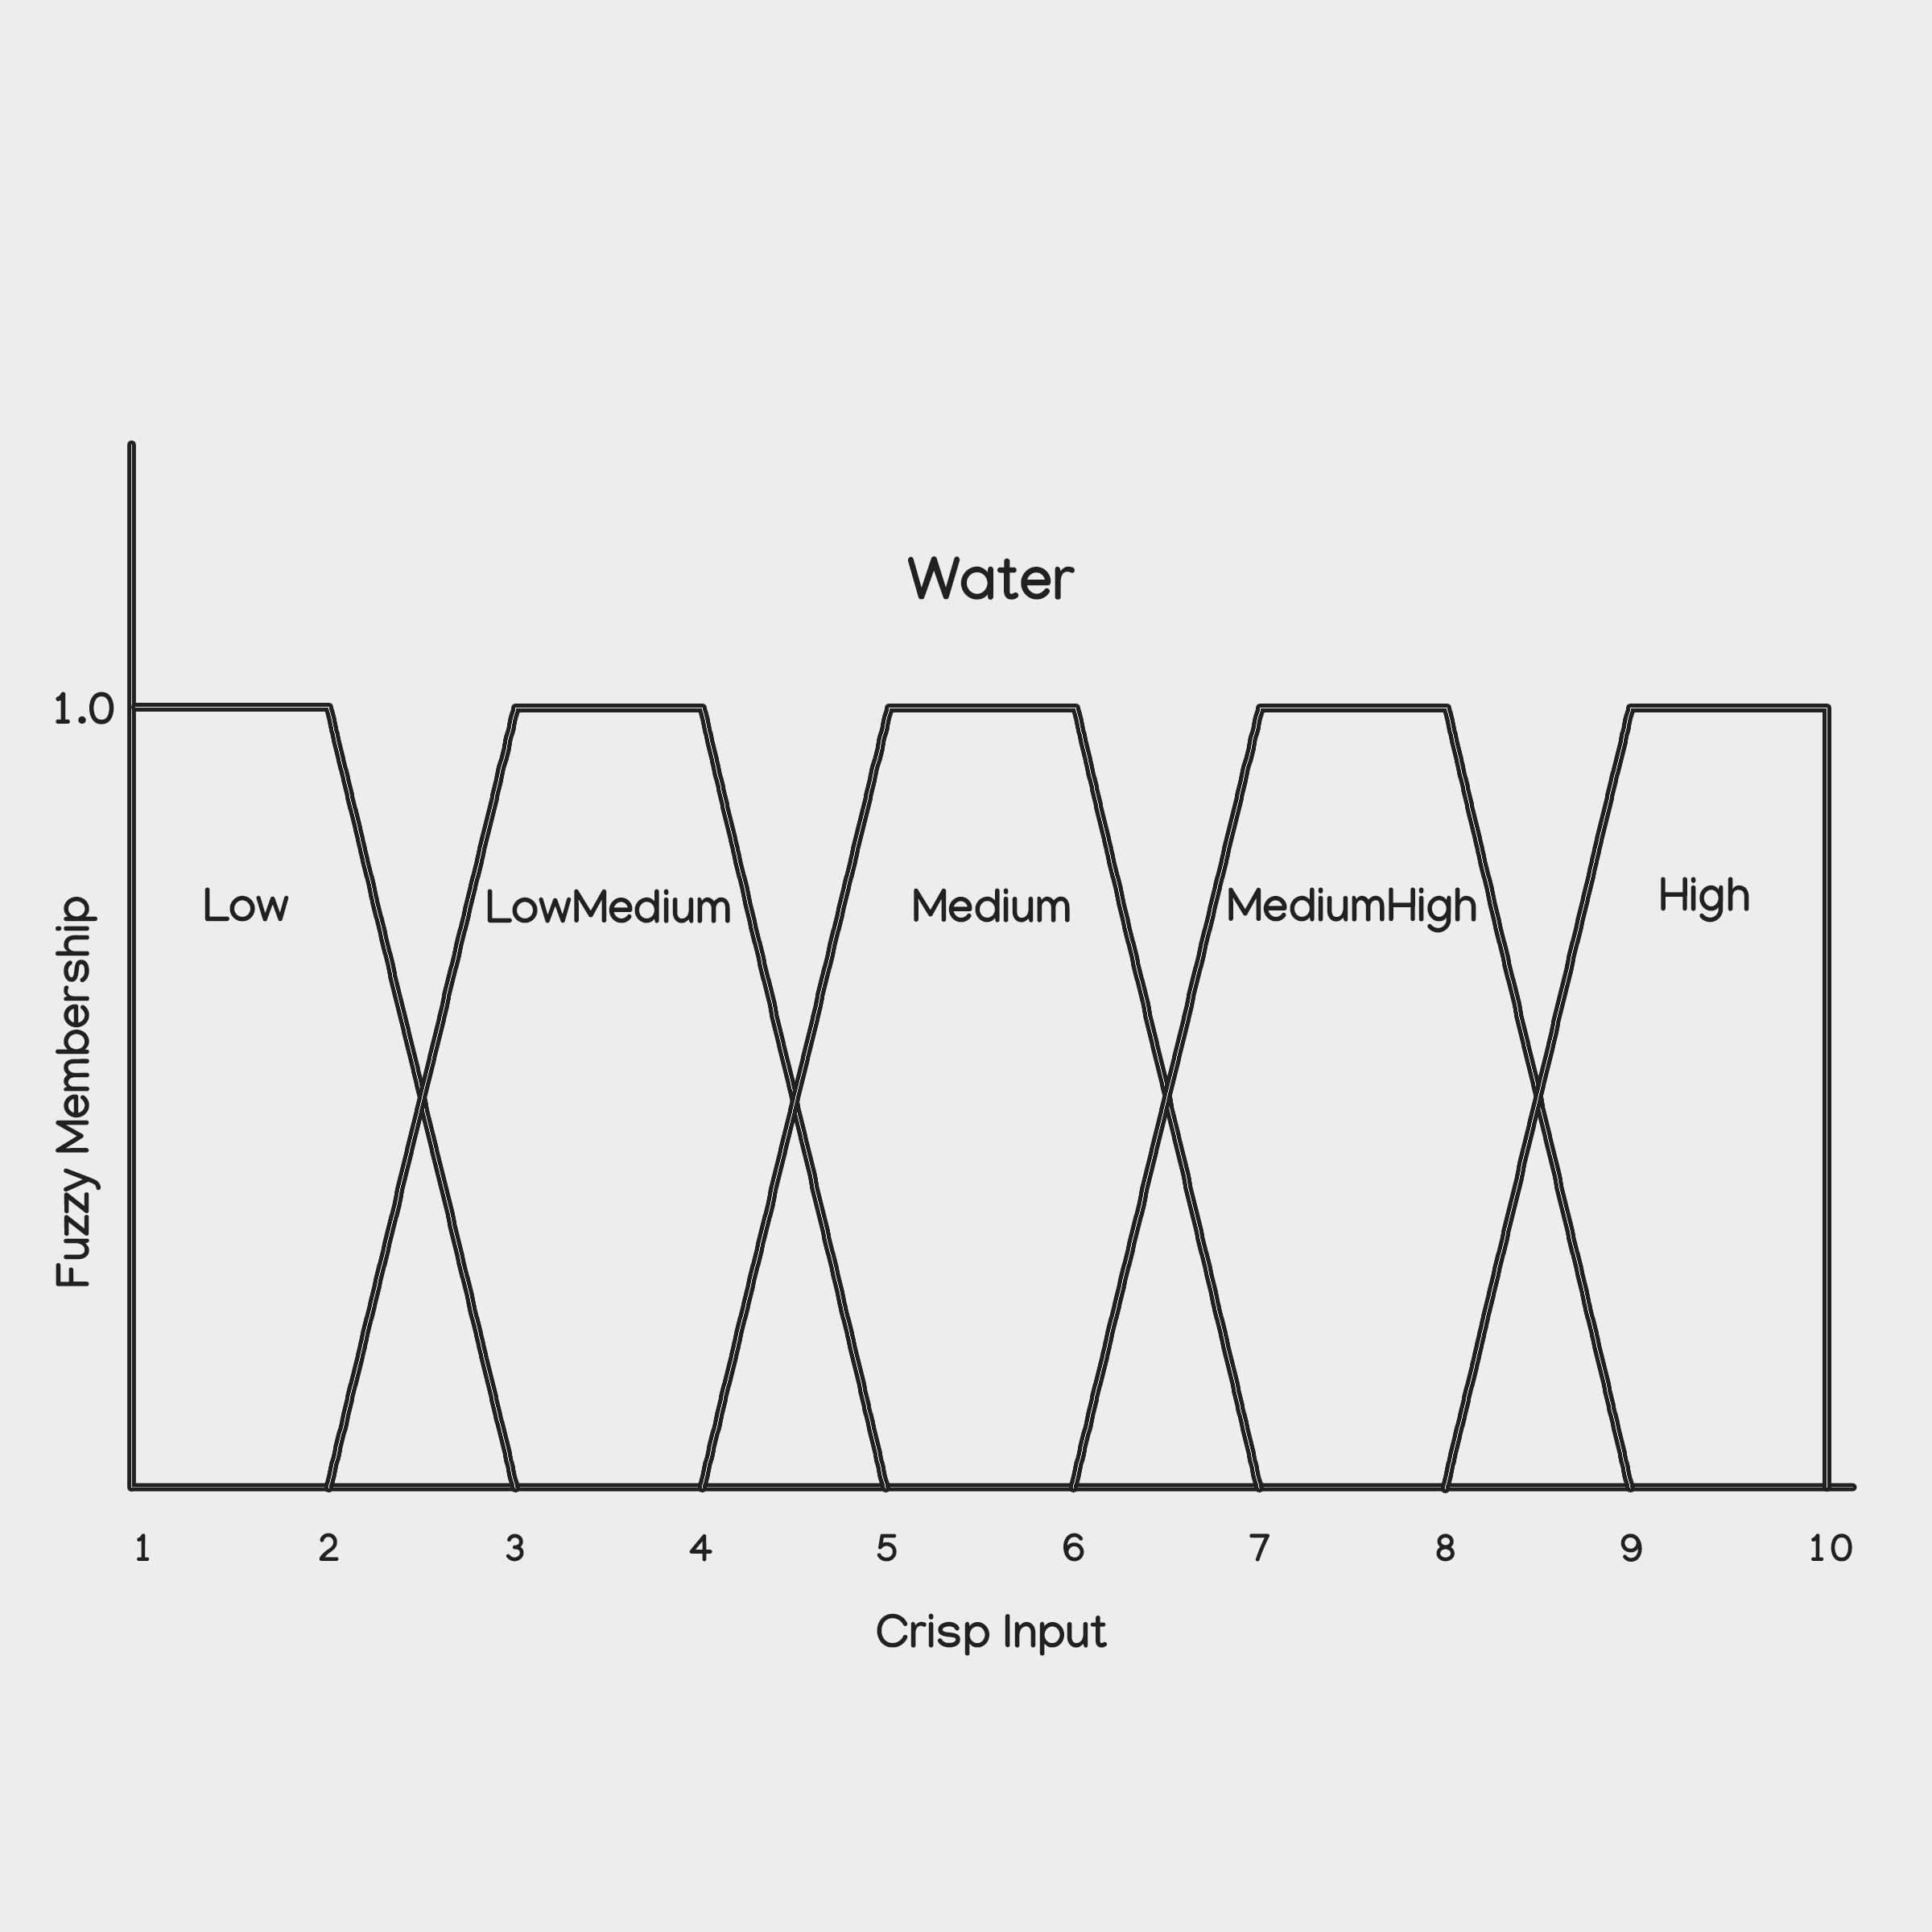
Membership Functions for Water Output

Slide 8
Rule Base for Water Output
 |  | Temperature
 |  | Cold | Warm | Hot
Soil Moisture | Dry | Medium | MediumHigh | High
 | Moist | LowMedium | Medium | MediumHigh
 | Wet | Low | Low | Low

Slide 9
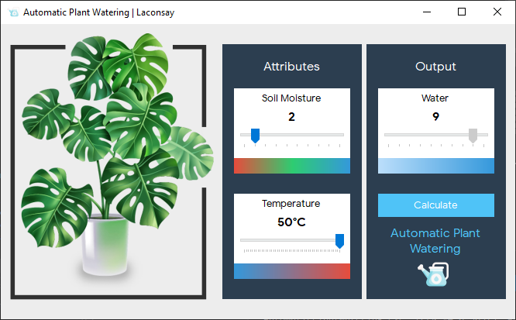

Demo

Slide 10
Thank you!
End

